Slide 1


END USER TRAINING
HUNT GROUPS
Notes:
Welcome to the hunt group tutorial.
This multimedia sales tool is intended as a high level overview for the end user customer, and is going to explain what a hunt group is - show five simple options that you can deploy – and help you to optimize the communications flow for your business.

Slide 2

The Importance of Hunt Groups
  With Hunt Groups, a business can:
  Have one phone number route to many people AND control how that routing occurs
  Provide an optimal sales and customer support experience by ensuring every call is answered
  Effectively handle peak hours, after-hours or low staff situations
Notes:
By deploying Hunt Groups, a business can:
*Have a single incoming number route to many people …AND control how that routing occurs
* Provide an optimal sales and support experience by ensuring every call is answered as quickly and efficiently as possible
* And effectively handle after hours, peak hours or low staff situations, using voice mail and other options

Slide 3

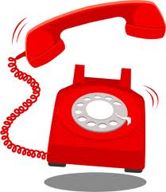



What is a Hunt Group?
  Allows incoming calls to a single business number to be distributed to a selected group of users
1 800 123 4567
Moje číslo “Anywhere”
240 123 4567
Notes:
Lets take a look at the key features of a hunt group.
A hunt group enables incoming calls to a single business number to be routed to a selected group of users.

Slide 4

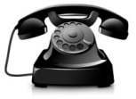
What is a Hunt Group?
  The call distribution is based on specific “hunting” or routing policies, optimized to the needs of the business
Incoming Call
Moje číslo “Anywhere”
240 123 4567
User 1
User 2
User 3
User 4
Notes:
The hunt group call distribution is based on specific routing policies, which can be customized to suit the specific needs of the business.
This includes configuring how long each phone will ring before moving on to the next – and, the total time that an unanswered call will be allowed to ring before moving to other options such as overflow users, or voicemail.
We’ll take a look at hunt group routing policies in more detail later on.

Slide 5


What is a Hunt Group?
  Calls are now answered faster and more efficiently, enabling a more professional appearance and better customer service
  Missed calls translate to missed revenue!
Moje číslo “Anywhere”
240 123 4567
Notes:
Hunt groups allow calls to be answered faster and more efficiently, which provides a much higher level of customer service for any size and type of business
*After all, missed calls translated into missed revenue.

Slide 6

Use Case: Spring Garden Florists
The Owner
The Team
Solution
  Local shop
  8 employees
  Peak and holiday hours
  Employees often multi-tasking
  Phone orders plus walk ins
  Also out on delivery
  All phones ring at once
  Whoever is available can pick up
  Can include mobile employees
Business Benefits
  Calls are picked up quickly by live person
  Professional front office appearance
  Increase in orders and revenue
Notes:
The first use case we’re going to look at is the fictional Spring Garden Florists, a small local shop who have to deal with peak period demands.
* The small team is often engaged with other duties, or are sometimes out on the road with deliveries.
*Because the team is so small, the owners never know exactly who is going to be in the shop. Therefore, all incoming calls will ring all the phones at once, so who ever is available can pick up the call. This is called a simultaneous hunt group.
The mobile phone numbers of the owners are also included in this hunt group, as they want to make sure that all calls are picked up live, if possible.
*The benefits for Spring Garden Florists include a professional appearance despite their small size, personal service and thus an increase in order uptake.

Slide 7
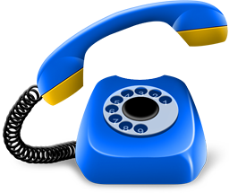


Hunt Group Policy: Simultaneous Routing
“Všechny telefony vyzvánějí zároveň”
“All phones ring at once”
Busy or
No Answer
Company Voicemail
Notes:
Lets take a look at how a simultaneous hunt group works.
*Incoming calls to the main number ring all the phones at once, letting anyone with a free hand pick up the calls. As mentioned, even mobile phone numbers can be included in the hunt group.
*Should no one be able to answer the phone, the owners decided to limit the amount of total time that callers would hear ringing to 30 seconds before going to voice mail, as they don’t want customers to get impatient and hang up.
And, when the shop closes at 5 pm sharp, all calls are immediately routed to voicemail.

Slide 8

Use Case: Napa Valley Winery
The Owner
The Staff
Solution
  Local winery
  25 employees
  Small office staff
  No dedicated receptionist
  Most calls are general inquiries
  Junior employees are expected to field the calls
  Calls start at the top of assigned list, and loop through until answered
  Back up users can be assigned
Business Benefits
  Senior staff shielded from picking up calls
  Callers only go to voice mail as a last resort
  Improved business efficiency
Notes:
Our next use case is the Napa Valley Winery.
The owner Steve employs about 25 people, and as there is no dedicated receptionist, he has assigned a small group to answer incoming calls.
* Some of these employees have more seniority than others, and Steve would prefer it if the more junior staff answered the phones first.
* Steve has chosen to deploy a solution that routes the incoming calls in a continuous loop through his assigned group – always starting with the same person first. This hunt group is called regular, or sequential.
The main benefit for Steve is that he can protect his more senior staff from having to answer a lot of calls, by defining who gets the calls first. Ultimately this helps Steve improve his business efficiency.

Slide 9

Hunt Group Policy: Regular (Sequential)
“Calls loop through the assigned list, always starting with User #1”
Napa Valley Winery
Hunt Group 240 123 5555
#1 Joe
Joe’s direct number
240 123 4444
#4 Heather
#2 George
#5 Steve as overflow
Company voicemail
#3 Tom
Notes:
Lets take a look at how a regular, or sequential, hunt group works.
*Incoming calls always start with user #1, who in this case is Joe.
*On busy or no answer, the calls continue to loop through the assigned list.
The owner Steve has chosen to limit incoming calls to two rings per phone, before the call moves on to the next phone.
*Should all the employees be engaged when a call comes in, a back up or overflow number – in this case Steve himself – can be defined. One or more overflow numbers can be assigned as necessary. Steve has decided after a total of 90 seconds, calls should go to his number.
* Should Steve not be available, the calls go to the company voicemail.
*Note that the main hunt group phone number for the company is a “virtual” phone number – and is different from other numbers, inlcuding individual employee numbers. As example, Joe has a separate number that will also ring his desk phone. He can easily tell if the call is coming from the hunt group or not by the caller ID display.

Slide 10

Use Case: Silver Spoon Design
The Owner
The Staff
Solution
  Multi location business
  Specialize in high end interior design
  Customer service number one priority
  Dedicated customer care per location
  Expertise differs by employee
  Fairly high turn over
  Separate number for each location
  Calls are distributed based on prioritized list
  Experienced employees get the calls first
Business Benefits
  Service calls never go unanswered
  Customers always satisfied by the best agent
  Return customers and referrals
Notes:
Our next example is Silver Spoon Design, a multi location regional chain where customer service is everything.
* There is a small but dedicated customer service group per retail location. The level of knowledge varies greatly between the agents, and the turnover can be fairly high.
Silver Spoon has assigned a virtual phone number for each of the four hunt groups, one for each retail location. Incoming calls are routed to the correct location by the phone number, and are then distributed on a prioritized basis – in this case, the most experienced agents always get the calls first.
This hunt group is called weighted call distribution.
* The benefit is that Silver Spoon’s high end customers always get the most knowledgeable agent possible on the call, resulting in an increase in return business and referrals.

Slide 11

Hunt Group Policy: Weighted Call Distribution
“Most experienced agent always gets the calls first”
“Hovor je vždy směrován nejprve na nejzkušenějšího zástupce”
Janine 50%
Busy or
No Answer
Sally 25%
Mary 25%
Lucy 0%
Notes:
In weighted call distribution, each employee is assigned a “weight” or priority, which adds up to 100%. As example:
* Janine is assigned 50% of the calls, as she is the most knowledgeable agent.
*Sally and Mary are about equal, so they are both assigned 25%.
*Lucy is new, but she can help out in a pinch – so Lucy is included in the group, but assigned 0% - this means Lucy will only get calls if all the other agents are busy.
* If all the employees are busy or, it is after hours, the calls go to a sophisticated voicemail system – referred to as Unified Messaging. Silver Spoon wants to make it easy for their employees to pick up their messages from wherever they are. With Unified Messaging, employees can pick up any type of message – email, fax, or even video messages – from a single unified inbox on their preferred device, including PCs and Smart phones.

Slide 12
Use Case: Harris Consulting, LLC
The Owner
The Staff
Solution
  Specialized consulting firm
  Top security clearance
  Word of mouth only
  8 employees
  Often out in field
  Top 5 technicians expected to answer calls when in office
  Calls cycle through an assigned list
  Notes the last user to answer a call, and then rings the next user on the list
Business Benefits
  Work load evenly distributed between employees
  Callers always get an expert
  Top gun reputation is maintained
Notes:
Our next use case is Harris Consulting , a small but very specialized consulting firm.
* Out of the 8 employees, about half are the top experts, and the owner, Mr. Harris, would like to ensure that they are the ones to answer incoming calls, which are typically from one of his existing customers.
* In this case, incoming calls always start with the person who follows the last person to receive a call in the assigned list.
This ensures the work load is distributed evenly amongst the small team, and everyone is given their turn of fielding calls. This solution is called a circular hunt group.
*Harris Consulting has now ensured their callers always get an expert, and their top reputation for confidentiality is maintained.

Slide 13

Hunt Group Policy: Circular
“
“The system notes the last user to answer a call, and then rings the next user on the list”
Dave just hung up
Peter’s phone will ring next
Followed by John
Followed by Steve
Busy or
No Answer
Company Voicemail
Notes:
In a circular hunt group, the system notes the last person to receive a call and then rings the next person on the list.
* As example, if Dave has just hung up,
* Peter’s phone will ring next,
*followed by John,
*and then followed by Steve.
*The owner Mr. Harris is also concerned about clients hearing ringing phones and getting no answer, so after only 20 seconds, the callers goes to voicemail.

Slide 14
Use Case: Hobbes Media, Inc.
The Owner
The Teams
Solution
  National firm with sensitive PR needs
  Dedicated PR teams handle outside inquiries
  Primary team answers calls full time
  Secondary team for overflow (“nested hunt group”)
  Callers are greeted by Auto Attendant
  Routed to first team, answered by longest idle employee
  If all busy, calls routed to secondary team
Business Benefits
  Calls efficiently routed to correct department with AA
  If first team busy, second team on stand by
  Company reputation kept intact
Notes:
Our last example is Hobbes Media, a national firm who handles the PR needs of very contentious clients.
* Hobbes has two teams to answer the calls; the first team is considered primary, and the second team is used as a back up, should the primary team be busy.
*All incoming callers to Hobbes Media are greeted by an auto attendant, where they are prompted to choose the correct department. Should they choose the PR department, they will be routed to the employee in the assigned group who has been idle the longest. This is knows as a uniform hunt group.
Should all the members of the team be busy, or there is no answer in a pre-defined period of time, the call is then sent to the second team. This scenario is known as a nested hunt group.
*The benefit for Hobbes Media is that all calls are routed quickly to the correct department; are then answered promptly by a live agent, even if the primary team is completely engaged - and Hobbes Media can continue to enjoy its reputation as the premier PR firm.

Slide 15



Auto Attendant and Nested Hunt Groups with Uniform Routing Policy
Auto Attendant
Professional Greeting
Omar
Chris
Press 1 for Directory
Press 4 for Public Relations
Busy or
No Answer
Alex
Press 2 for Sales
Press 5 for Finance
Suzanne
Press 3 for Marketing
Press 0 for Live Receptionist
Group One
Group Two
Notes:
Lets take a look at how an auto attendant and hunt groups can work together.
All incoming calls are greeted by the Auto Attendant, prompting the user to choose the correct department.
* In this case, the user chooses the PR department. The call is immediately routed to a primary group of workers, using a Uniform hunt group. This means the system looks for the employee who has been idle the longest – which happens to be Chris.
* If all the employees in the PR department are busy, or there is no answer, the call will be routed to the secondary hunt group. This is known as a nested hunt group. The company has also chosen to use the same routing policy for the second group, but they could have chosen any other routing policy.

Slide 16

Are Hunt Groups Hard to Set Up?
Contact your Service Provider for additional information
With a few pieces of key information, your hunt group can be quickly configured:
Define Hunt Group Name & Telephone Number
Choose users on the assigned list
Ring Order – Circular, Regular, Simultaneous, Uniform or Weighted
No Answer Settings - Number of rings, total duration of ring back
Other options such as overflow users and voice mail
Notes:
Hunt Groups are simple to configure, and only require a few pieces of key information. Your company’s group administrator, or your service provider, can simply click through an easy to use web portal which prompts the user for the required information.
*To find out more about what hunt groups can do for your organization, please contact your Service Provider.

Slide 17
Summary – Hunt Groups
Work well in combination with other front office services such as Auto Attendant, Voice Mail and Unified Messaging
Are easy for administrators to deploy and offer many customizable options
MORE than just call forwarding!
Increase workplace efficiency, customer capture and retention for organizations of all sizes and types
Notes:
In closing, let’s take a quick look at the key benefits of Hunt Groups.
*As you’ve seen throughout this tutorial, Hunt Groups are much more than simple call forwarding.
*Hunt Groups are very easy to configure and deploy.
They work well with other front office services such as Auto Attendant, Voice Mail, and Unified Messaging.
And finally, they increase workplace efficiency, as well as increase customer capture and retention rates for all types of organizations.
This ends our Hunt Group tutorial – thank you for watching.

Slide 18
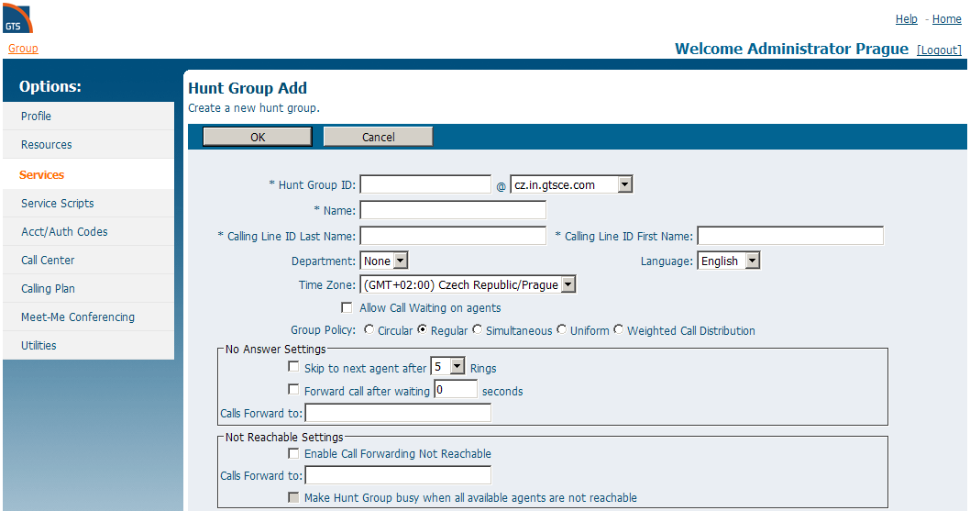
Huntgroup configuration
Notes:
Nastavení skupiny vyzvedávání hovoru je přístupné po přihlášení do portálu centrex.gts.cz v menu Služby -> Sériová linka. Zde je seznam všech existujících skupin, a tlačítkem Upravit je možno měnit jejich nastavení. Pro přidání nové skupiny stiskněte tlačítko Přidat a objeví se následující okno. Políčka označená * je nutno vyplnit. Dále je třeba vybrat, jakým způsobem budou příchozí hovory přidělovány jednotlivým uživatelům ve skupině, což se provádí označením jedné z voleb pod položkou Politika skupiny. Podrobnější popis jednotlivých možností je dostupný v pomoci (odkaz v pravém horním rohu).

Slide 19
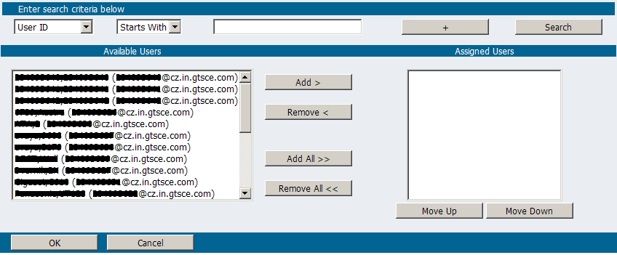
Huntgroups users assignmemt

Slide 20
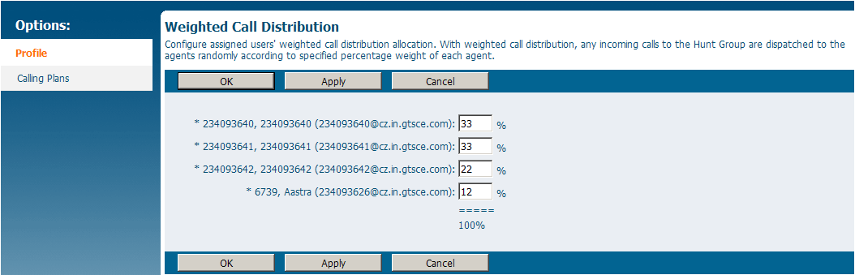
Weighted call distribution

