Slide 1


End User Training
Hosted Front Office Services
Auto Attendant
ACD (Automatic Call Distribution)
Queuing
Notes:
Welcome to the tutorial on front office services.
This multimedia sales tool is intended as a high level overview for the end user customer, and is going to explain how to optimize the management of incoming calls for your business. This tutorial will cover: Auto attendant - Automatic Call Distribution – and - Queuing.

Slide 2


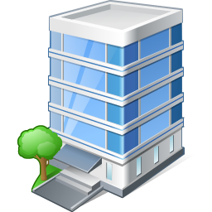





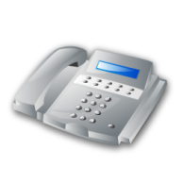
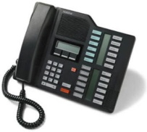
Overview: Front Office Services
  Auto Attendant: An automated receptionist that provides professional greetings and guides callers
  Automatic Call Distribution: Intelligently distributes calls to a defined set of recipients
  Queuing: Holds callers until the appropriate employee is available to pick up the call
Notes:
Every single business requires some type of front office service. From home-based businesses right up to large enterprises, inbound calls need to be managed in the most efficient way possible.
We are going to take a look at three of these services and the value of these services in a hosted environment. Let’s start with a brief description of each.
*An auto attendant is a service that most people are familiar with. Incoming callers receive a customized greeting, and are prompted to enter options such as “Press 1 for Service, or, Press 2 for Sales.” Other options may include dialing by extension or name.
*Automatic Call Distribution – often referred to as ACD - quickly distributes callers to an appropriate person or group. Using different routing policies, businesses can decide how, when and to who the incoming calls are distributed . We’ll take a deeper look at this later on in the tutorial.
*Queuing is an efficient way to manage incoming calls, when its undesirable to have callers receive a busy signal or be routed to voice mail. Callers may first dial into an auto attendant, or can dial directly to the queue itself.
When in the queue, callers will receive an appropriate greeting or announcement while waiting for the designated resource to pick up the call.
Let’s take a look at two use case scenarios that will help explain how auto attendant, ACD and queuing can work together to provide a more efficient front office.

Slide 3



Use Case: Wyatt Construction, Inc.
The Company
The Situation
Solution
  Commercial construction services
  120 to 140 employees
  Aging PBX system not able to handle new requirements
  Limited DID numbers
  Administrators overburdened
  Users frustrated by lack of control
  Hosted PBX and Auto Attendant
  Dial by Extension
  User self service via web or voice portal
Moje číslo “Anywhere”
240 123 4567
Business Benefits
  Increase in productivity by alleviating the front desk burden
  Improved customer satisfaction
  Users empowered to manage their own reachability
Notes:
Our first use case is a fictional commercial construction company.
Wyatt Construction is a regional construction company with about 40 employees in the office, and about 80 to 100 out in the field. The number of field employees can vary greatly by season, with summer being their busiest season. Their old PBX system was becoming too difficult and expensive to maintain. However, in order to replace it with a similar system, they would have to pay for a fixed capacity that would support their largest number of users….there was no flexibility to scale up or down with the seasonal fluctuations, as there is with a hosted solution.
*Sam, the IT manager, needed to solve a few key issues. Wyatt Construction had a very limited number of DID (or, direct inward dial) phone numbers due to cost reasons. This meant that when all were in use, the next caller got a busy signal.
Additionally, employees out in the field seldom handed out their cell phone numbers, as they often were not free to answer them. This increased the incoming traffic to the main number, and the three administrators who answered the phones were now answering between 3 and 400 calls a day – in addition to their primary responsibilities. During peak times, some of the calls simply could not be answered. Sam was asked to help free up the admins so they could attend to other duties, and alleviate the busy and no answer scenarios.
The other request was to provide the field workers with the ability to manage their own schedules of when and where they received phone calls. Sam was already over burdened with the time he spent managing the old voice system, and did not have time to dynamically manage personal schedules.
*The solution was to move to hosted PBX with an Auto Attendant. Callers now receive a professional greeting, and are given options to dial by extension, press O for the operator, or leave a message in the company voice mail box. This alone relieved the admins of about 25 man hours per week of answering calls.
And, via an easy to use web or voice portal, field workers can now access their personal settings to manage their own call control, such as call forward to their cell phone, change their voicemail setting, or create fixed schedules for how and when they are reached.
*The Business Benefits for Wyatt Construction include cost savings, flexibility and a big increase in efficiency. Incoming callers now never receive a busy signal, the admins can focus on higher level tasks, and the employees have been empowered to manage their own personal communication preferences.

Slide 4

Use Case: Time Travel, Inc.
The Company
The Situation
Solution
  National chain of six independent offices
  Specialize in seniors and retirees
  About 100 dispersed customer service employees
  Multiple different phone systems
  Increase in business, but trouble with staff
  Hunt groups just not cutting it anymore
  Auto Attendant, ACD and Queuing
  Consolidate agents and systems
  Single queue which spans agents and locations
Moje číslo “Anywhere”
240 123 4567
Business Benefits
  Professional appearance with consistent greetings
  Increase in close rate
  Cost savings with hosted network queuing
Notes:
Our next example is Time Travel, a small chain of travel agencies that focuses on services for seniors.
Time Travel has six offices spread across the country in major city centers, and about 200 employees. About half of these are customer service employees that handle the sales and service inquiries. Many of them work from home – some are part time, and some are full time.
*Time Travel has recently expanded by making local acquisitions, and thus the offices all have different PBX systems - which was a headache from an IT management point of view, and expensive to maintain. The larger offices had been using hunt groups – often referred to as “sales ring groups”- to help handle the incoming calls. The smaller offices were still relying on a single receptionist to manually distribute the calls to the customer service employees.
This had worked well in the past, but as they were experiencing a significant increase in business, they were having trouble keeping up with the calls. In the larger offices, the hunt groups were just not sufficient for the amount of incoming traffic, and many callers ended up in voicemail - not an ideal situation for a travel agency with a lot of competition. And in the smaller offices with the single receptionist, callers were often receiving a busy signal during peak times.
*It was time to move to a hosted solution, so that Time Traveler could consolidate both people and systems, and take advantage of the benefits of hosted PBX combined with Auto Attendant, ACD and Queuing.
Now, regardless of whether callers dialed a local office number or the new 1 800 number, they reached an auto attendant that guided them to choose the right group. If they chose Sales, the call would be routed to a single queue that spanned all the agents in all of the offices, and then distributed the call to the first available agent, regardless of location – including home based agents.
*Time Traveler can now present a consistent professional appearance, regardless of the size or location of each office, and is able to efficiently handle even peak periods of incoming calls. This means that more callers are connected directly to a live agent, which results in a much higher close rate.
An unexpected bonus for Time Traveler was the cost savings associated with network queuing. As calls are now queued up in the service providers network, Time Traveler does not have to pay for multiple phone lines to each office to handle the separate queues.
Let’s take a look at the value of network queuing in more detail on the next slide.

Slide 5
Queuing with a Premise Based PBX
Service Provider
Calls Queued Here
Calls Queued Here
Moje číslo “Anywhere”
240 123 4567
Lokation C
Location A
Locarion B
Calls Queued Here
Notes:
In order to understand the difference between queuing in a hosted and non- hosted environment, lets first take a look at the traditional way to handle queuing in a non-hosted environment.
* Currently, Time Traveler has an on premise PBX in each location. In order to support queuing, they would need enough phone lines, or trunks, to support both the active and queued calls, as all the calls would be queued to each local PBX.
*As example, lets say Location A had 50 customer service agents. Time Traveler might need to purchase a line for each agent, plus roughly another 50 to 100 lines for the queued calls that are holding , depending on traffic expectations.
You can see how this would be a very expensive proposition for busy customer service centers.

Slide 6

The Value of Network Queuing
Service
Provider
Hosted
Calls Queued here
Lokation C
Location A
Location B
Notes:
With a hosted solution, each location would be connected to the service providers network via data trunks, * and any queued calls awaiting an available agent would be queued in the service providers network, not at each business location.
With this architecture, a customer service center with 50 agents would only need a total of 50 lines, or more accurately, 50 seats or licenses. This would generate a significant cost saving for the business.
*Additionally, network queuing would allow Time Traveler to configure business continuity rules that would route calls to other locations, including their home based workers, in the event of a local outage or disaster.
Now, we are going to take a deeper look at the different types of Automatic Call Distribution routing options.

Slide 7
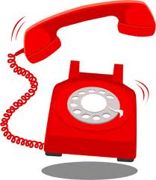
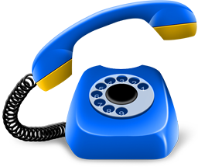
ACD Policy: Simultaneous Routing
“Všechny telefony vyzvánějí zároveň”
“All phones ring at once”
Notes:
There are five different types of ACD options.
The first one is simultaneous routing, which is just as it sounds.
*Incoming calls to the main number ring all the phones at once, letting anyone with a free hand pick up the calls. Even mobile phone numbers can be included in the group, if required.

Slide 8

ACD Policy: Regular (Sequential)
“Calls loop through the assigned list, always starting with User #1”
#1 Joe
#4 Heather
#2 George
#3 Tom
Notes:
Next up is a regular, or sequential, routing.
*Incoming calls always start with user #1 in an assigned list, who in this case is Joe.
*On busy or no answer, the calls will continue to loop through the assigned list. A timer can be deployed to make sure the caller does not listen to too many rings, before being routed to the next employee.

Slide 9
ACD Policy: Weighted Call Distribution
“Most experienced agent always gets the calls first”
Janine 50%
Sally 25%
Mary 25%
Lucy 0%
Notes:
In weighted call distribution, each employee is assigned a “weight” or priority, which adds up to 100%. As example:
* Janine is assigned 50% of the calls, as she is the most knowledgeable employee.
*Sally and Mary are about equal, so they are both assigned 25%.
*Lucy is new, but she can help out in a pinch – so Lucy is included in the group, but assigned 0% - this means Lucy will only get calls if all the other employees are busy.

Slide 10
ACD Policy: Circular
“The system notes the last user to answer a call, and then rings the next user on the list”
Dave just hung up
Peter’s phone will ring next
Followed by John
Followed by Steve
Notes:
In a circular policy, the system notes the last person to receive a call and then rings the next person on the list.
* As example, if Dave has just hung up,
* Peter’s phone will ring next,
*followed by John,
*and then followed by Steve.

Slide 11






Auto Attendant, ACD and Queuing - Working Together
Queue
Auto Attendant
ACD
Group One
ACD
Group Two
Professional Greeting
Omar
Press 1 for Directory
Press 4 for Service
Chris
Press 2 for Sales
Press 5 for Finance
Alex
Suzanne
Press 3 for Marketing
Press 0 for Live Receptionist
Notes:
Now that we’ve explored ACD and Network Queuing in detail, let’s take a look at how auto attendant, ACD and Queuing can work together.
All incoming calls are greeted by the Auto Attendant, prompting the user to choose the correct department.
* In this case, the user chooses the Service department, and the call is then put into a queue that is customized for the service department. As example, a greeting might inform the caller that their call will be picked up as soon as possible, and then tells them about the current service specials that are available. When an employee becomes available, the call is routed as per the chosen ACD policy.
* In this example we are introducing the fifth ACD option – Uniform routing. This means that the system simply looks for the employee who has been idle the longest – which happens to be Chris.
* In a really large organization with a very busy customer service group, the call could be routed to a secondary ACD group. This is known as a nested group, and can use the same or a different routing policy.

Slide 12

Summary – Hosted Front Office Services
Significant benefits vs. traditional on premise solutions
Auto Attendant alleviates office workers of routine call handling duties
ACD and Queuing provide more efficient call handling and increased customer satisfaction
Network queuing offers significant cost savings and business continuity options
Notes:
In closing, let’s take a quick look at the key benefits of hosted Front Office Services.
Hosted front office services, including auto attendant, ACD and queuing, can offer greater business efficiencies and cost savings than traditional on premise solutions.
* Auto attendant alone can alleviate office workers from many man-hours of routine call handling which can be better served by an automated system.
Together, ACD and Queuing can add a layer of professionalism to any business, offering a more efficient way to handle incoming calls, increasing customer service and satisfaction
* And finally, network queuing offers significant cost savings and business continuity benefits not available with other solutions
This ends our Front Office tutorial – thank you for watching, and please consult with your service provider for more details on how hosted front office services can help

Slide 13
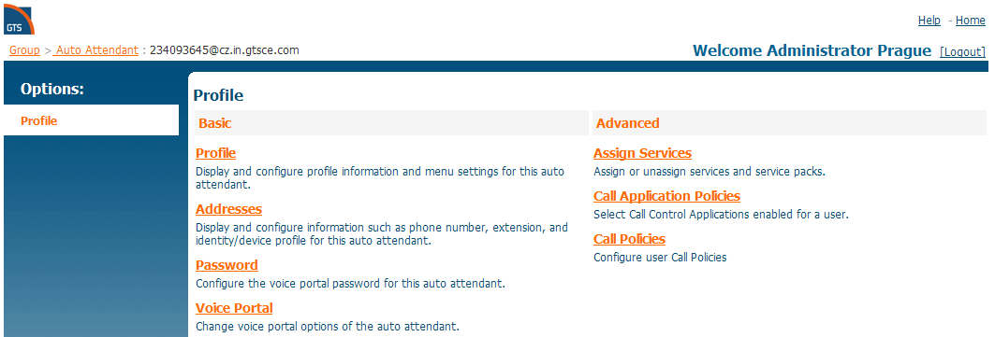
front office settings

Slide 14
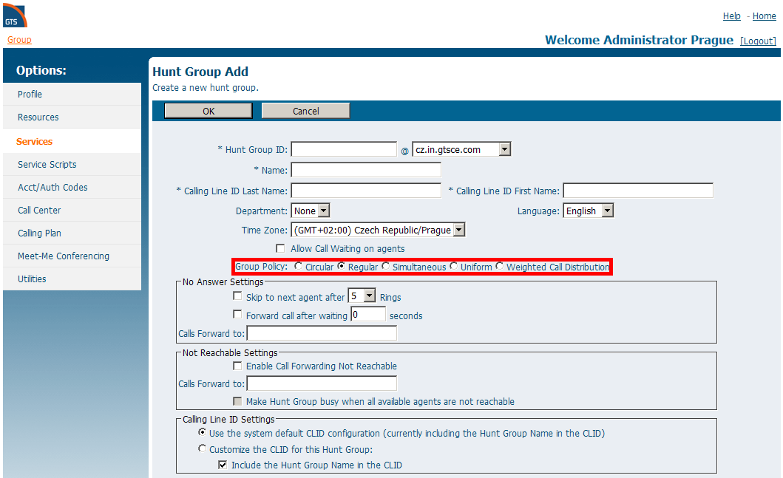
Front Office settings

